Slide 1

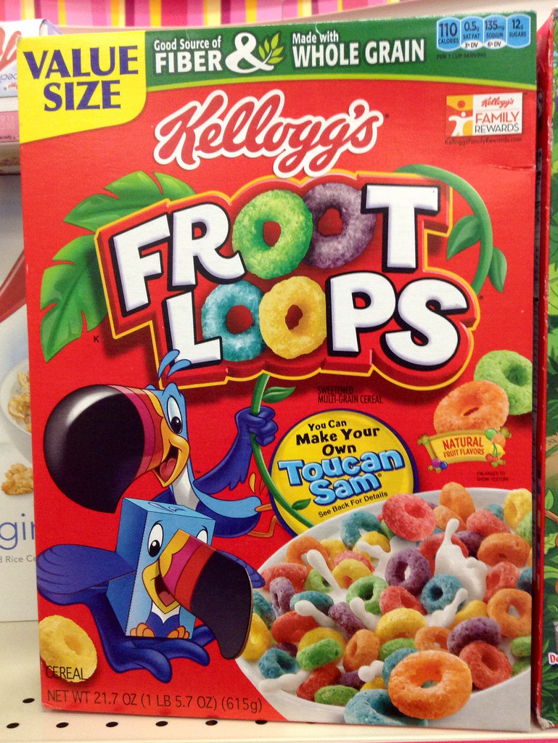


All about loops and how to avoid them

Slide 2


Loops
Vectorized functions
-Do not require learning new syntax
-Slow
-Clunky
-Often hard to interpret
-
-Have their own syntax
-Fast
-Elegant

Slide 3
What’s a loop?
“Looping”, “cycling”, or “iterating” is nothing more than automating a multi-step process by organizing sequences of actions or ‘batch’ processes and by grouping the parts that need to be repeated.

Slide 4
Two general types of loops
Some loops execute for a prescribed number of times, as controlled by a counter or an index, incremented at each iteration cycle. These are part of the for loop family.
On the other hand, some loops are based on the onset and verification of a logical condition. The condition is tested at the start or the end of the loop construct. These variants belong to the while or repeat family of loops, respectively.

Slide 5
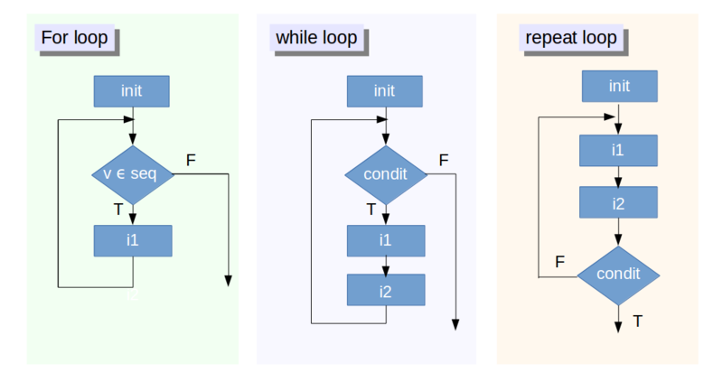

Slide 6
Golden rules of loops
Don’t use a loop when a vectorized alternative exists
Don’t grow objects (via c, cbind, etc) during the loop - R has to create a new object and copy across the information just to add a new element or row/column
Allocate an object to hold the results and fill it in during the loop

Slide 7
Be careful when you use repeat: make sure that a termination is explicitly set by testing a condition or you can end up in an infinite loop.
Warning

Slide 8
Breaks
When the R interpreter encounters a break, it will pass control to the instruction immediately after the end of the loop (if any). In the case of nested loops, the break will permit to exit only from the innermost loop.

Slide 9
Next
next discontinues a particular iteration and jumps to the next cycle.

Slide 10
When to use loops?
It is generally suggested to avoid loops whenever possible
R enjoys a feature that few programming languages do, which is called vectorization

Slide 11
What is Vectorization?
As the word suggest, vectorization is the operation of converting repeated operations on simple numbers (“scalars”) into single operations on vectors or matrices. You have seen several examples of this in the subsections above.

Slide 12
Apply?
The first three are the most frequently used:
apply()
You want to apply a given function to the rows (index “1”) or columns (index “2”) of a matrix.
lapply()
You want to apply a given function to every element of a list and obtain a list as a result (which explains the “l” in the function name).
sapply()
You want to apply a given function to every element of a list but you wish to obtain a vector rather than a list.

Slide 13
lapply() method loops over a list and evaluates a function on each element.
sapply() method is a simplified version of lapply().
apply() method evaluates a function on the boundaries or margins of an array.
tapply() method evaluates a function over subsets of a vector.
mapply() method is a multivariate version of lapply().

Slide 14
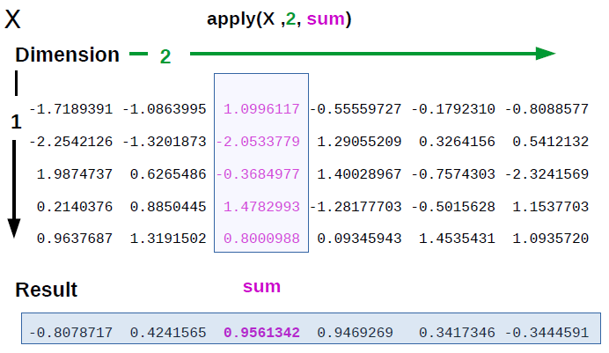
‘Apply’ evaluated a function over the margins of an array (or matrix)

Slide 15
lapply
lapply() takes a list and a function as input and evaluates that function over each element of the list. If the input list is not a list, it is converted into a list using the as.list() function before the output is returned. It is much faster than a normal loop because the actual looping is done internally using C code.

Slide 16
sapply
similar to lapply() except that it tries to simplify the results wherever possible. For example, if the final result is such that every element is of length 1, it returns a vector, if the length of every element in the result is the same but more than 1, a matrix is returned, and if it is not able to simplify the results, we get the same result as lapply()

Slide 17
tapply
The function tapply() is used to evaluate a function over the subsets of any vector.

Slide 18
mapply
The mapply() function is a multivariate version of lapply() and is used to evaluate a function in parallel over sets of arguments.

